Slide 1
Overview:
Site
Regions
Cold Pool & Covariates
Potential Approach to Detect Cold Pool Influence

Slide 2
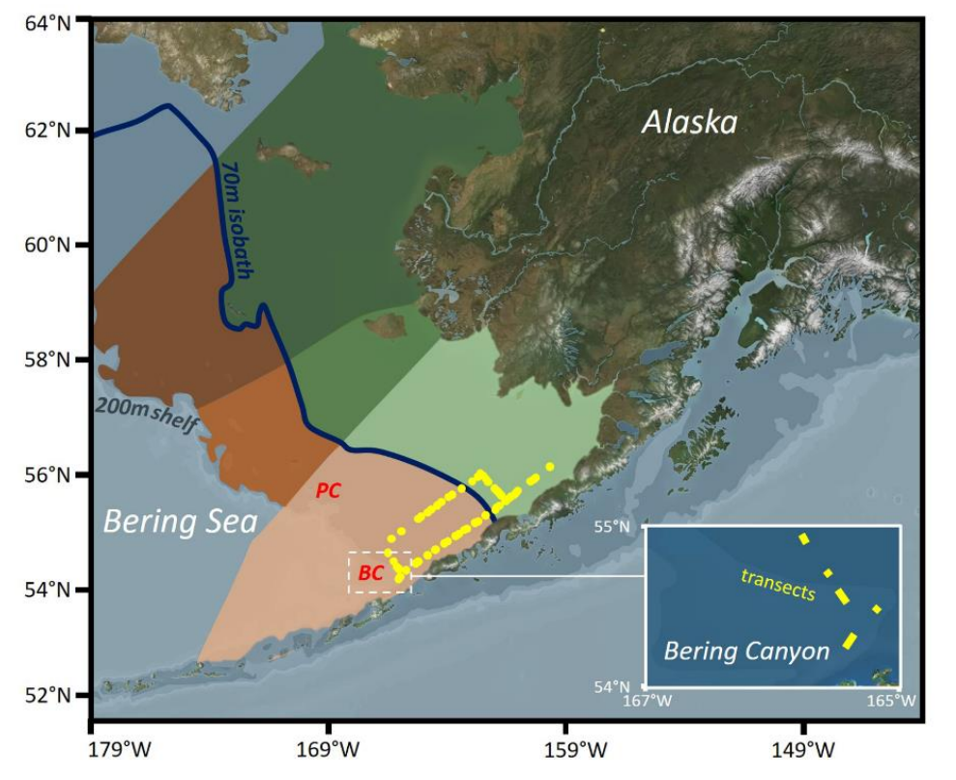
Proposed Regions:

Slide 3
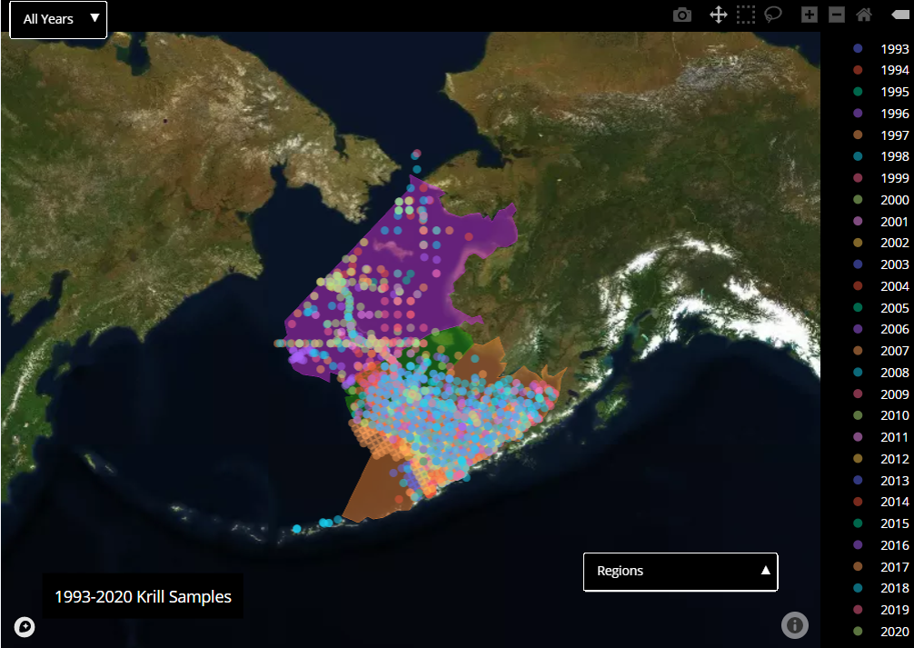
Statistically Realistic Regions:

Slide 4
Cold Pool
Sea Surface Temperature
Ocean Depth

Slide 5
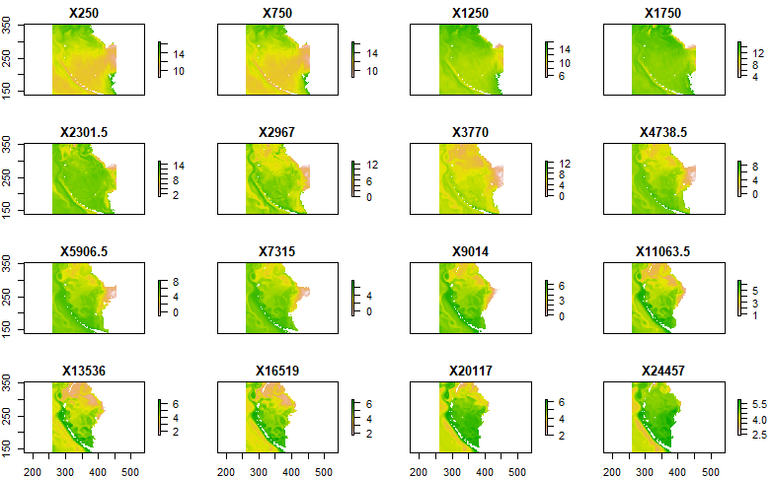
Circulation: Currents
At
Depth

Slide 6
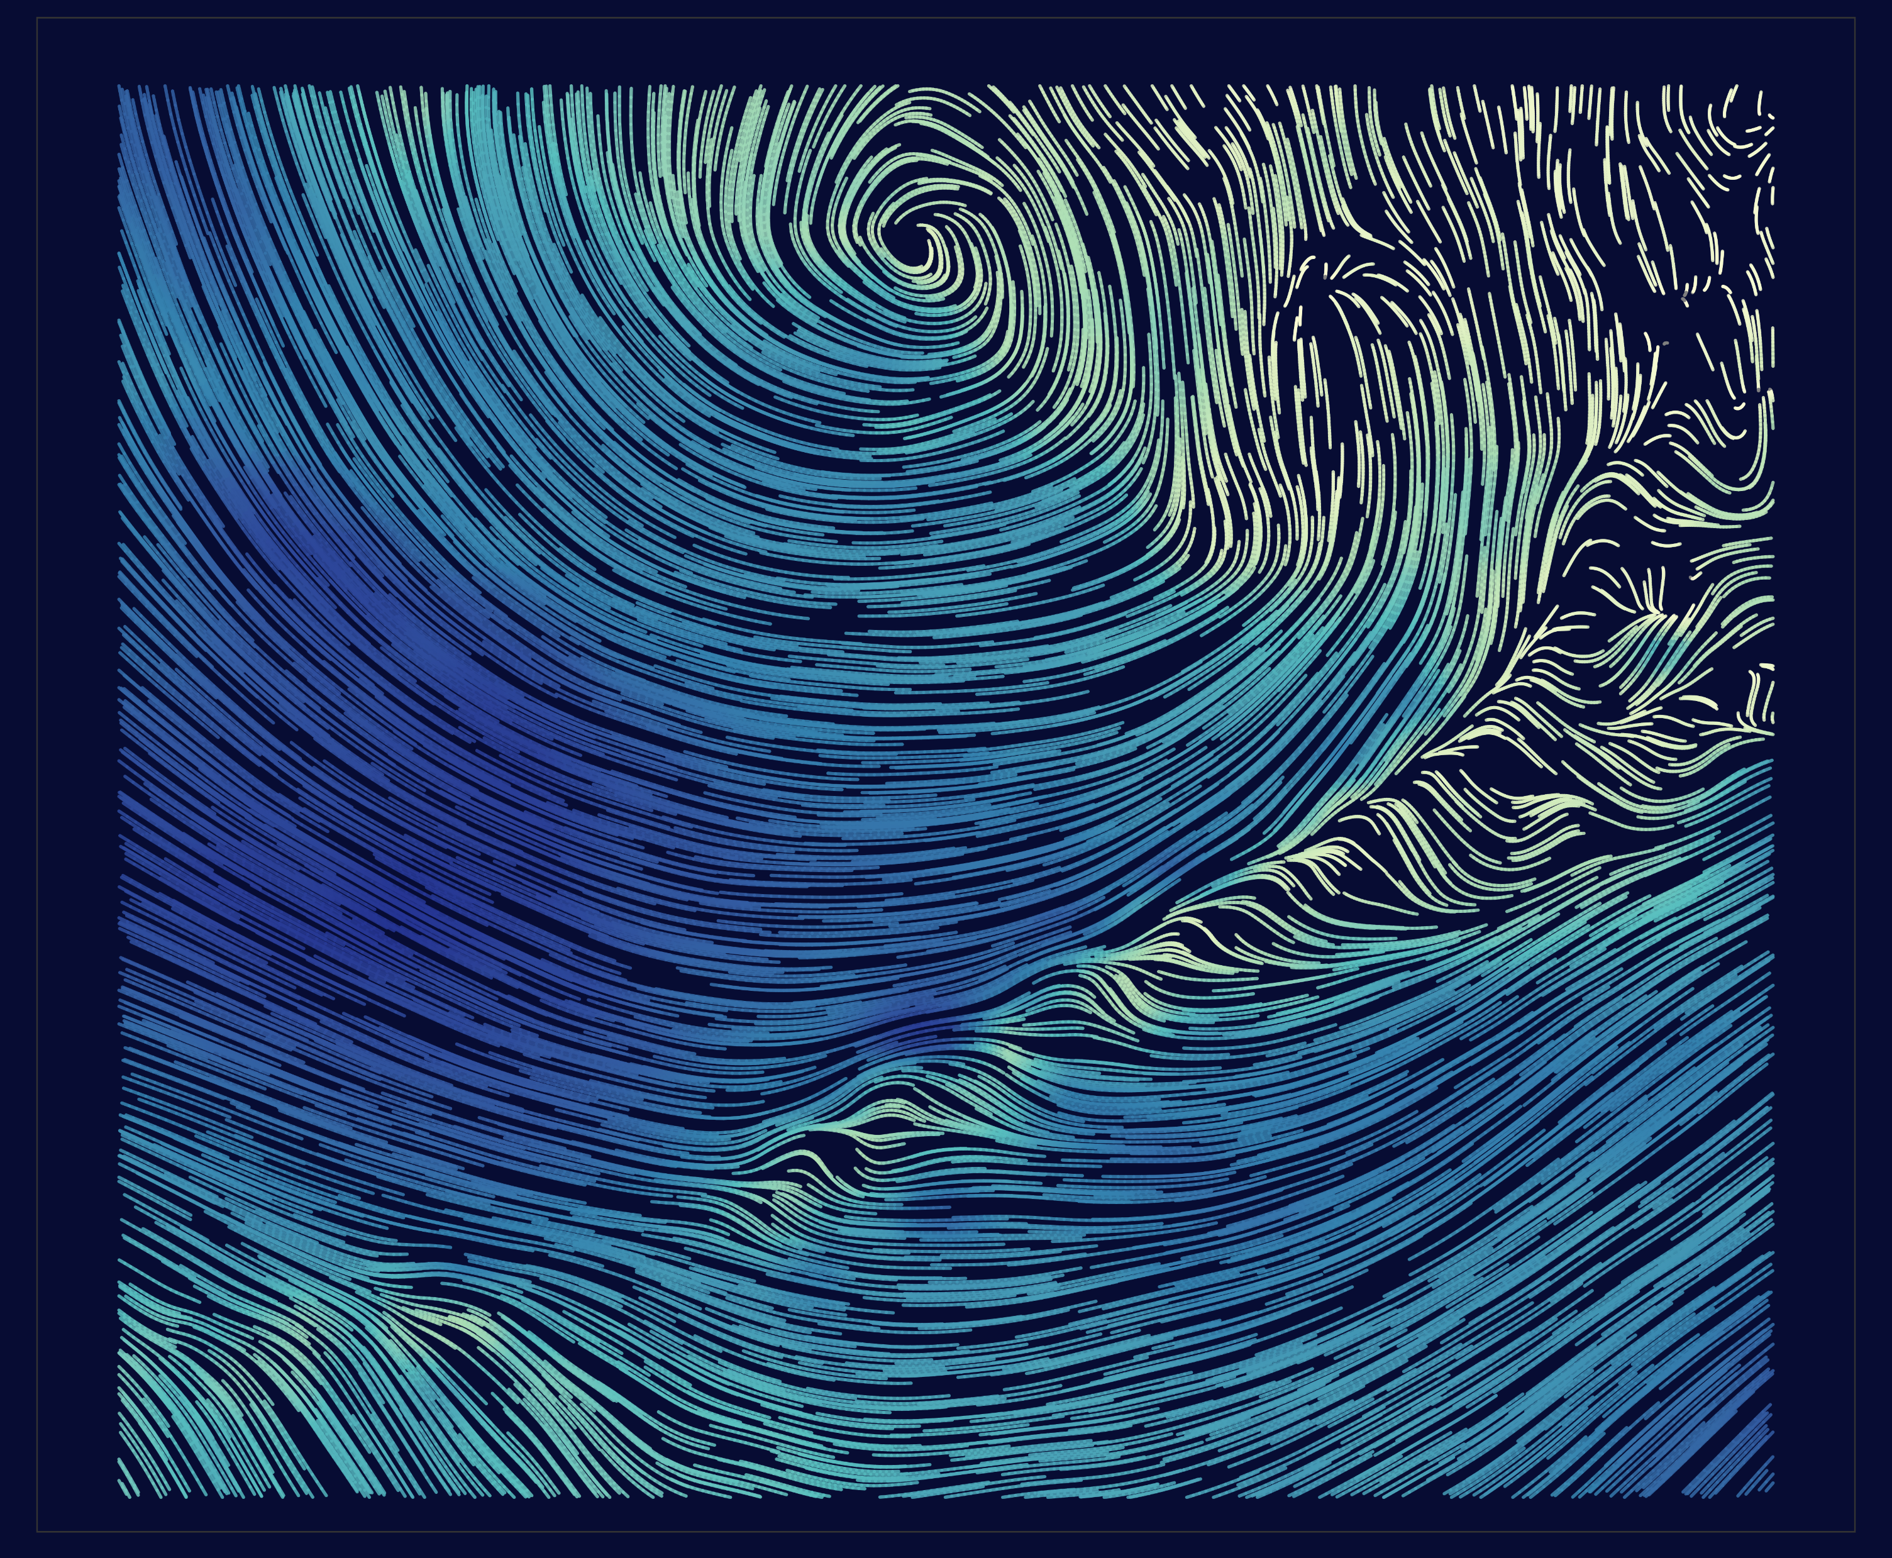
Circulation: Wind

Slide 7
Temporal changes: monthly (pictured) and annually (not shown)
Cold Pool
Sea Surface Temperature
Ocean Depth

Slide 8
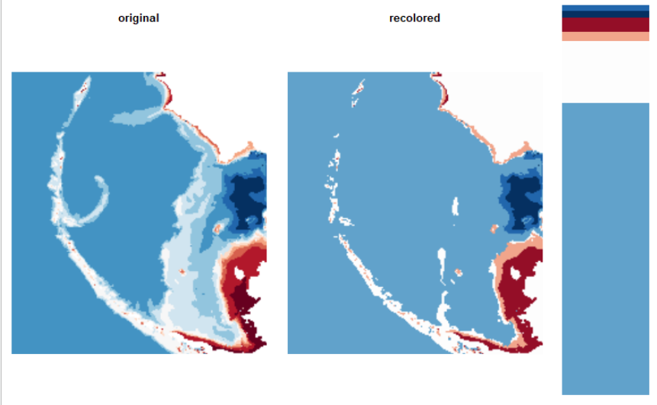
Bin all of the pixels into specified number of clusters per channel:

Slide 9
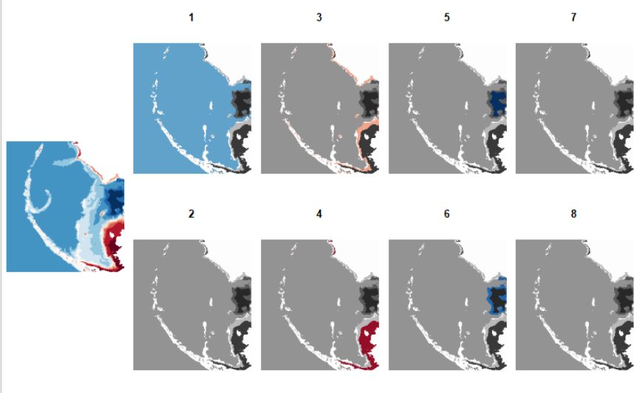
Re-cluster and divide patches per unit (ex: channel, color, threshold):

Slide 10
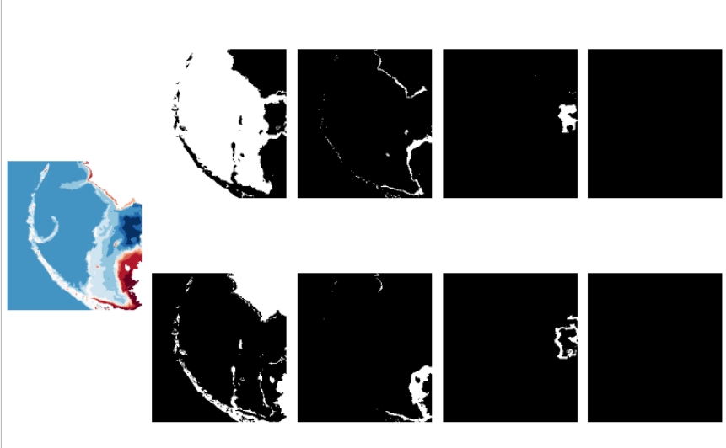
Separate color clusters into binary masks:

Slide 11
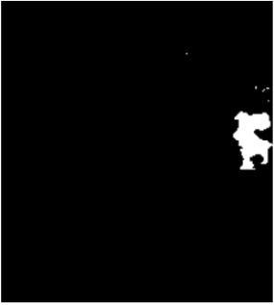

Polygons are now reproducible, and calculations or machine learning can begin:
Cold Pool Threshold
Nearby Diffusion

